Slide 1
FPGA Implementation of In-Memory Search Macro with Range Encoding
Speaker : B11901027 王仁軒
Mentor : Rick Huang
Advisor: Prof. An-Yeu (Andy) Wu
Date : 2025/05/02

Slide 2
Outline
Introduction to few-shot learning
BORE range encoding scheme
IMS system architecture
Implementation on FPGA
Direct implementation
Revised implementation
Input stimuli generation
Result
Display received data with LED

Slide 3
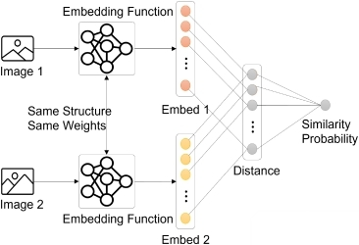
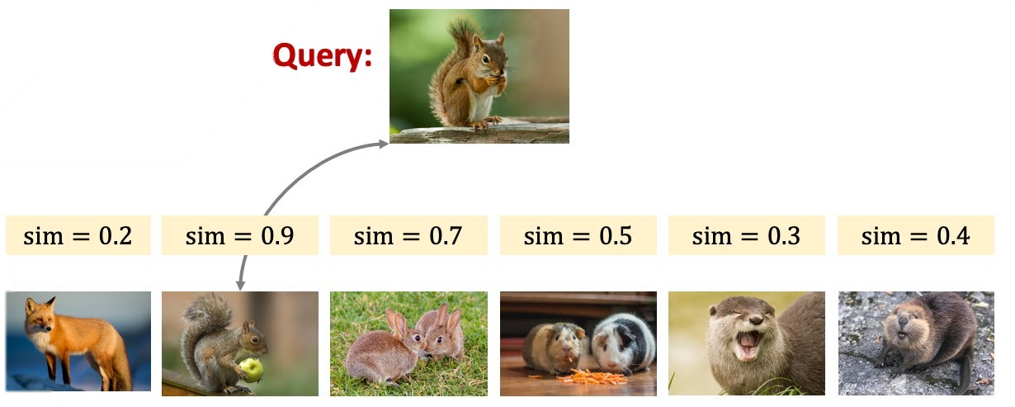
Few Shot Learning
In few-shot learning, we compare similarity between query and supporting data in memory
Process input with NN
Compute similarity between query and supporting embeddings
In memory

Slide 4
Similarity Search
Similarity Search
Which class does query belong to?
Iteratively expand from query
Less space Long time
1
3
2
Overlap
query
Take advantages of both method
1
2
query
Create squares from existing data
More space Short time
1
query
Expand supporting data in advance
Iteratively expand query data

Slide 5
System Architecture
TOP
in
in
Word
Encoder
Mask data
Mask
Encoder
Encoder_en
Controller
Write_en
word
mask
Search_en
Buffer
Buffer
Buffer
Buffer
TCAM Bit-line Generator
M1
M2
M3
M4
M5
M6
M7
M8
Match
Post Processing Unit
Address

Slide 6
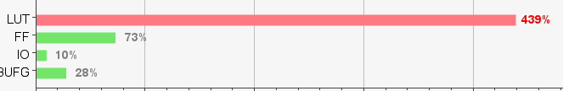
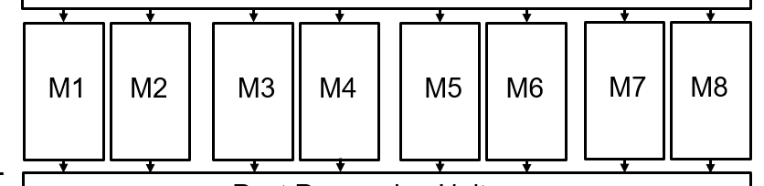
Direct Implementation
Some Issue happened when implementing on FPGA directly
Too complicated
FPGA board has limited ALU resources
Reduce the use of ALU

Slide 7
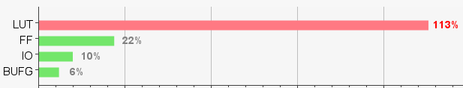
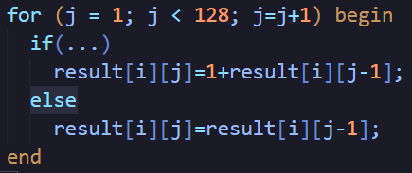
Direct Implementation
Some Issue happened when implementing on FPGA directly
After removing unnecessary blocks
Still not simple enough
Rewrite memory macro
+
+
+
+
Smaller
Faster
+
+
+
x128
Large 3D array
+
Adder Tree

Slide 8
Revised System Architecture
TOP
in
in
Word
Encoder
Mask data
Mask
Encoder
Encoder_en
Controller
Write_en
word
Search_en
mask
Buffer
TCAM Bit-line Generator
M1
M2
Match
Post Processing Unit
Address

Slide 9

Input Stimuli Generation
Input stimuli were provided by testbench $→$ Non-synthesizable
Rewrite testbench into a synthesizable module
Using RAM on FPGA board to preload data
Support Data RAM
addr
TB
data
FSM
in
Encoder_en
TOP
Query Data RAM
addr
Input
Gen.
Write_en
data
Search_en
Golden
Data RAM
addr
Result
Checker
Match
Address
data
LED

Slide 10
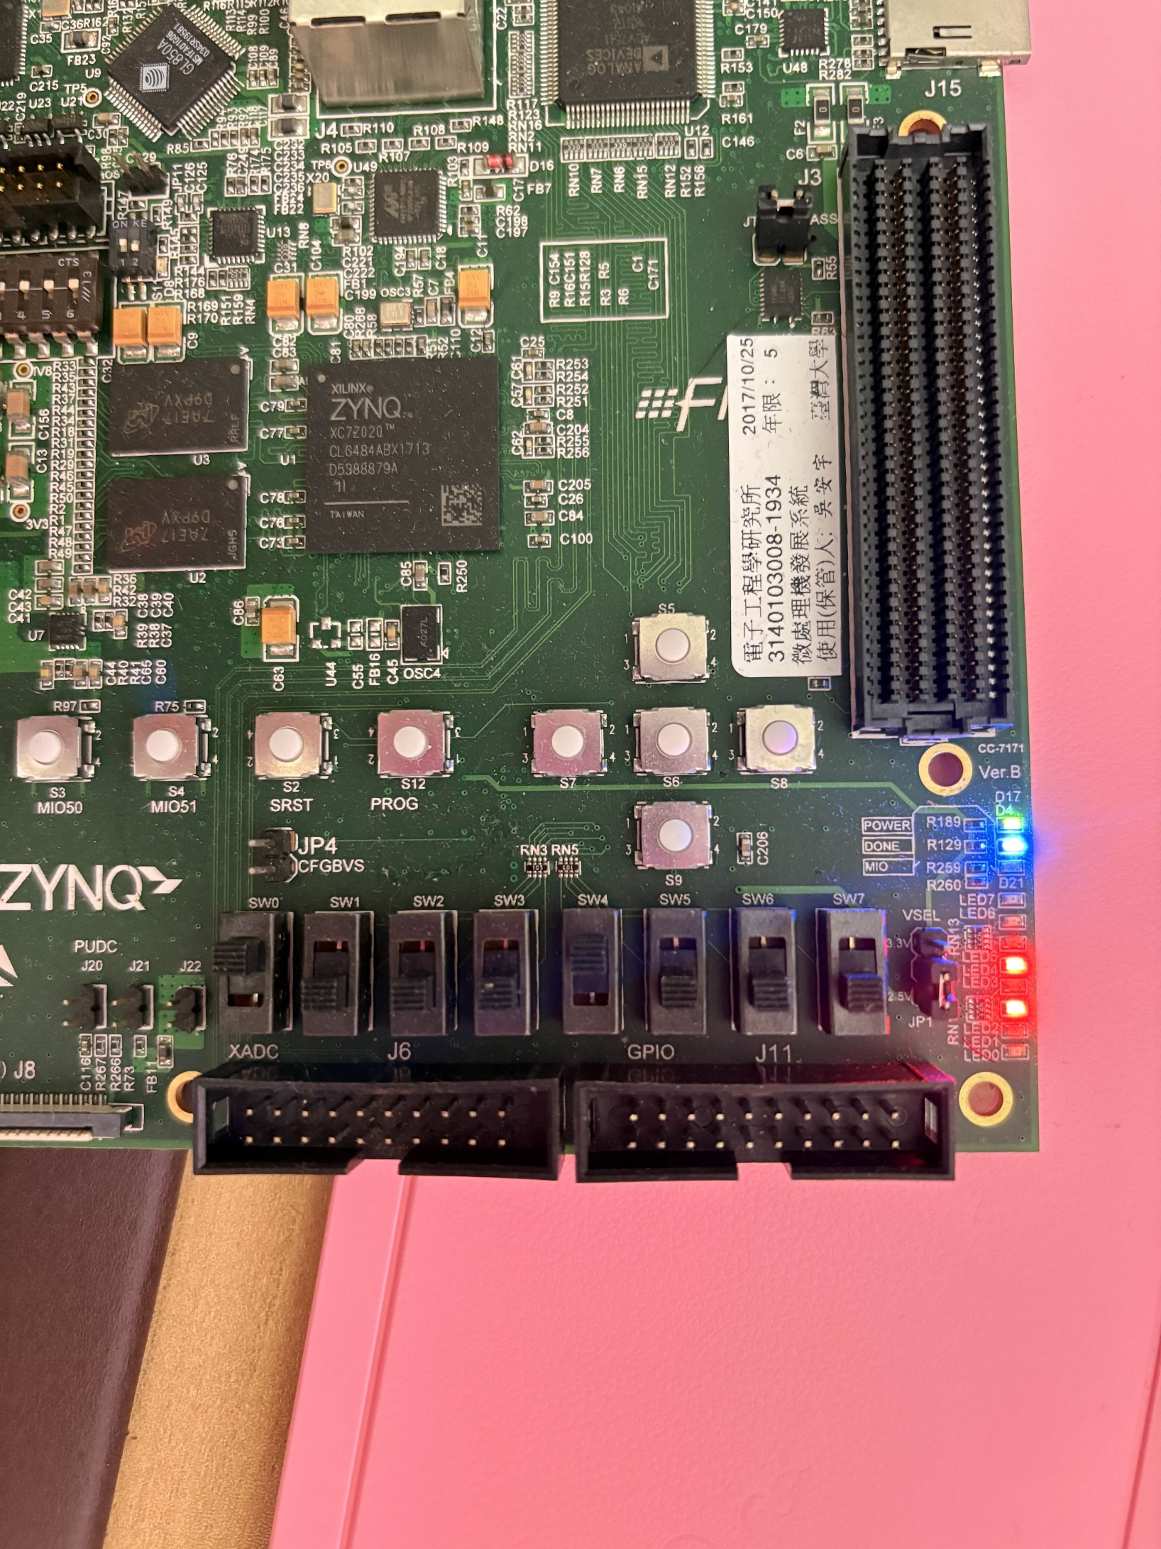
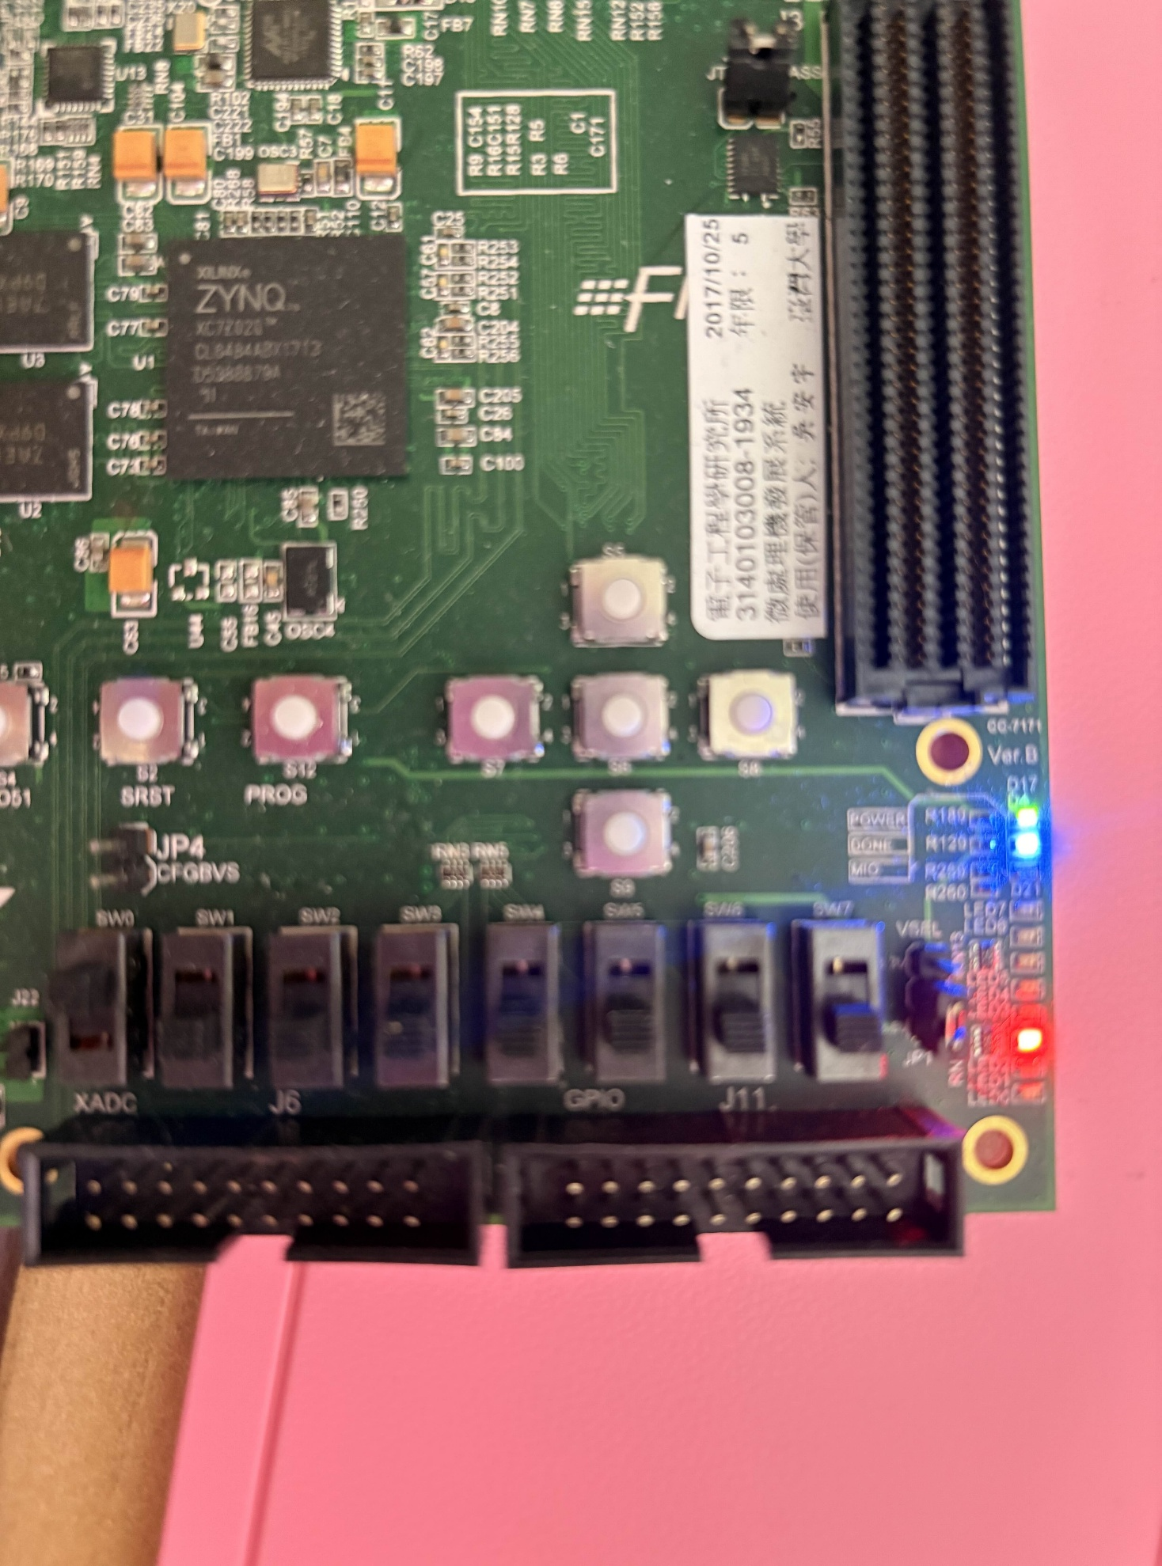
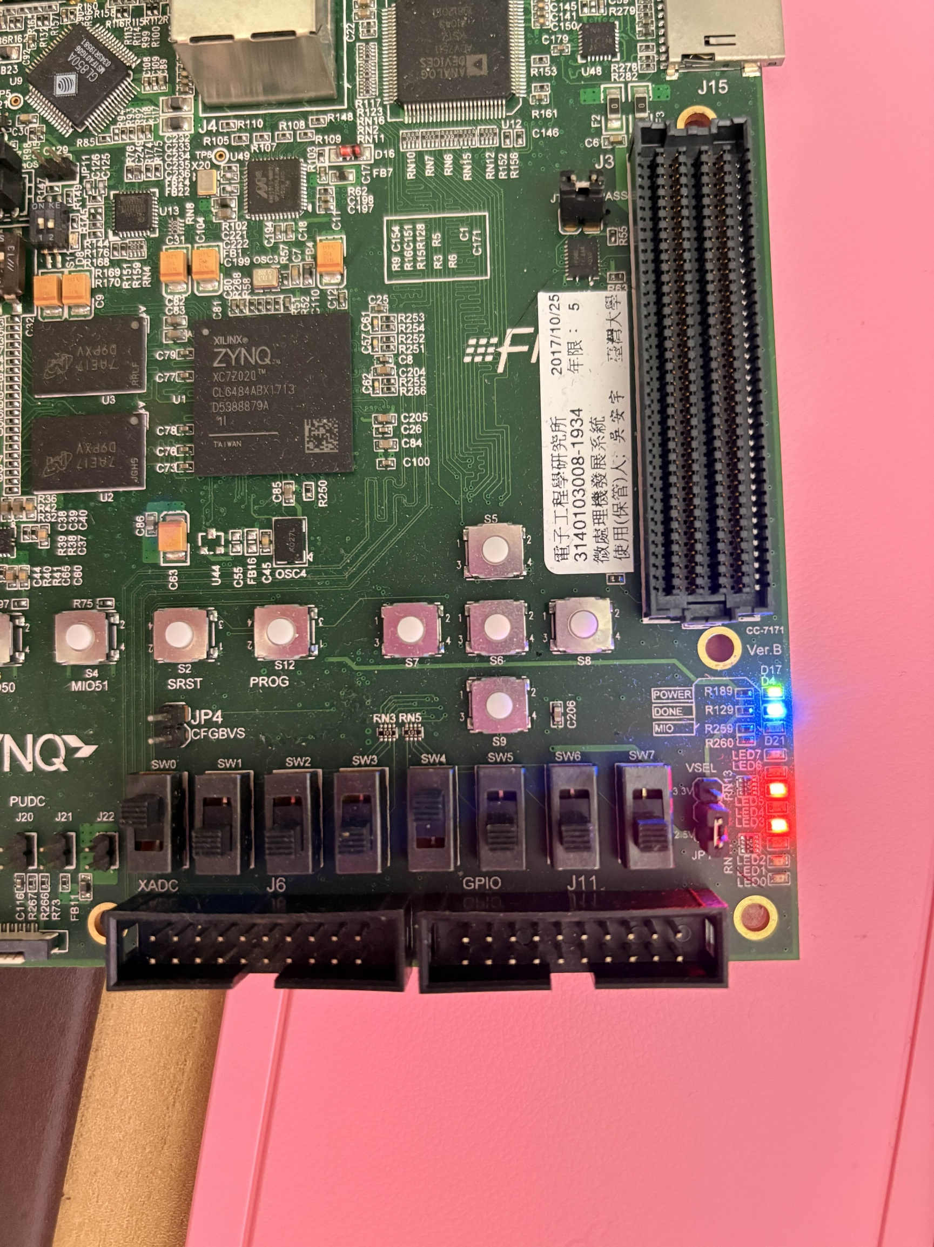
Result
After start signal is sent, TB receives MATCH signal from TOP once Search SW is triggered (active low)
LED shows the ADDRESS signal
LED Config
Address
Finish
Search
Search
Search
Address = (1010)2=10
Address = (10)2=2
Address = (10100)2=20

